Slide 1
Information and Communication Technology (ICT)

Slide 2

Introduction
Information and Communication Technology (ICT or TIC in French) refers to the integration of telecommunications and computers to access, store, transmit, understand, and manipulate information. It encompasses unified communications and the role of enterprise software, middleware, storage, and audiovisual technologies.

Slide 3
Importance of ICT (TIC)
Universal Access
ICT provides the opportunity for all individuals, regardless of their location or background, to access educational resources and information.
Equity
ICT helps bridge the digital divide and ensures equal opportunities for all learners, regardless of their socioeconomic status or geographical location.
Professional Development
ICT enables educators to improve their skills and knowledge through online courses, collaborative platforms, and access to a wide range of educational resources.
Quality Learning and Teaching
ICT enhances the learning experience by providing interactive and engaging content, personalized learning opportunities, and effective teaching methods.
Efficient Management
ICT streamlines administrative tasks, data management, and communication within educational institutions, leading to more efficient operations and resource allocation.

Slide 4
Why Learn ICT (TIC)
Job Opportunities Learning ICT opens up a wide range of job opportunities in the technology industry. | Personal Skill Development Learning ICT helps develop valuable skills that are applicable in various personal and professional settings. | Learning and Research Facilitation ICT facilitates learning and research by providing access to vast amounts of information and resources.
Social Interaction ICT enables social interaction through various communication platforms and social media. | Productivity Improvement ICT tools and technologies enhance productivity by automating tasks and streamlining workflows. | Innovation and Entrepreneurship ICT fosters innovation and entrepreneurship by providing tools and platforms for idea development and implementation.
Broadening Learning Horizons ICT expands learning horizons by offering access to online courses, educational resources, and global networks. | Enhanced Understanding of Technology Learning ICT provides a deeper understanding of technology and its impact on society. | Self-Employment and Personal Projects ICT skills can be utilized for self-employment and personal projects, allowing individuals to pursue their passions and goals.

Slide 5



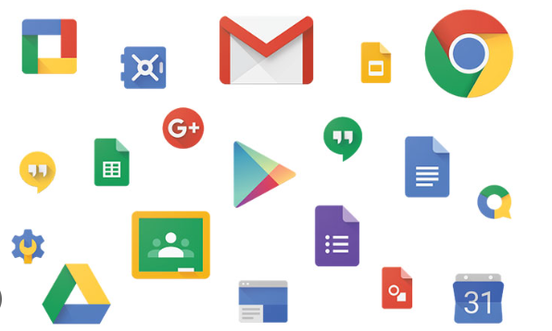
Technologies Related to ICT (TIC)
Git and GitHub
Git and GitHub are essential tools for version control and collaboration in software development projects.
Microsoft Tools
Microsoft Tools, including Word, Excel, PowerPoint, and Visual Studio, are widely used in various aspects of ICT and professional development.
Overleaf (LaTeX)
Overleaf is a popular online platform for collaborative writing and editing of LaTeX documents, commonly used in academic and scientific fields.
Google Services
Google Services, such as Google Docs, Google Sheets, and Google Slides, offer cloud-based productivity tools for collaboration and document management.

Slide 6
Git and GitHub
Git: Distributed Version Control System
Git is a distributed version control system that allows multiple developers to collaborate on a project and track changes efficiently.
GitHub: Web Hosting Platform
GitHub is a web hosting platform for Git projects. It provides a centralized location for storing and managing code repositories.
Benefits of Git and GitHub
Change Tracking: Git allows developers to track changes made to a project, making it easier to identify and revert to previous versions if needed.
Effective Collaboration: Git and GitHub enable seamless collaboration among developers, allowing them to work on the same project simultaneously and merge their changes efficiently.
Quick Retrieval: With Git, developers can easily retrieve previous versions of a project, making it convenient for debugging and troubleshooting.
Security: Git provides secure version control, ensuring that only authorized individuals can access and modify the project's code.
Flexibility of Work: Git allows developers to work offline and synchronize their changes with the central repository when they regain internet connectivity.

Slide 7



Microsoft Tools
Microsoft Office
Microsoft Office is a suite of many productivity tools that includes Word, Excel, PowerPoint, and more. These tools are widely used in education and professional settings for creating documents, analysing data, and delivering presentations.
Microsoft Word is a word processing program that allows users to create and edit text documents, used for multiple purposes : Education, Work …..
Microsoft Excel is a spreadsheet that enables users to perform numerical calculations, create tables, and coduct data analysis, making it useful for financial operations and statistics.
Microsoft PowerPoint is a program for preparing and presenting slideshows, allowing the creation of advanced slides containing text, images, and graphics to illustrate ideas and informations.

Slide 8

Microsoft Tools
Visual Studio
Visual Studio is an integrated development environment (IDE) provided by Microsoft and used for creating software applications. It provides a range of tools and features to support the development process, including code editing, debugging, testing, managing projects…
Writing and Debugging :
Visual Studio provides a powerful code editor with features like code highlighting, auto-completion, and code navigation. It also includes advanced debugging tools to help developers identify and fix issues in their code.
Project Management and Testing :
With Visual Studio, developers can easily manage their projects, organize code files, and collaborate with team members. It also offers comprehensive testing tools to ensure the quality and reliability of the applications being developed.

Slide 9

Journal Templates and Direct Submission :
Overleaf partners with scientific publishers to provide LaTeX templates for journal articles. These templates ensure that authors can easily format their documents according to the journal's guidelines. Additionally, Overleaf offers direct submission links to streamline the publication process.
Collaborative LaTeX Editor :
Overleaf (LaTeX) is a cloud-based LaTeX editor that enables collaborative writing, editing, and publishing of scientific documents. It provides a user-friendly interface and real-time collaboration features, allowing multiple users to work on the same document simultaneously.

Slide 10
Google services in IT
Google Workspace :
Google Workspace offers a suite of cloud-based productivity tools including Gmail, Google Drive, Google Docs, Google Sheets, and Google Slides. It provides a collaborative environment for teams to work together efficiently and securely.
Google Cloud Platform :
Google Cloud Platform offers a wide range of cloud computing services, including computing, storage, and machine learning. It allows businesses to build, deploy, and scale applications using Google's infrastructure.

Slide 11
Conclusion
A comprehensive understanding of the technological services offered by Google and Microsoft, including Git and GitHub tools, contributes to the enhancement of technical capabilities and fosters innovation in the workplace context.

